Slide 1
MFIN 841: Lecture #2, Spring 2017
Lecture 2: Social Media in Financial Markets
Professor Ryan Riordan

Slide 2
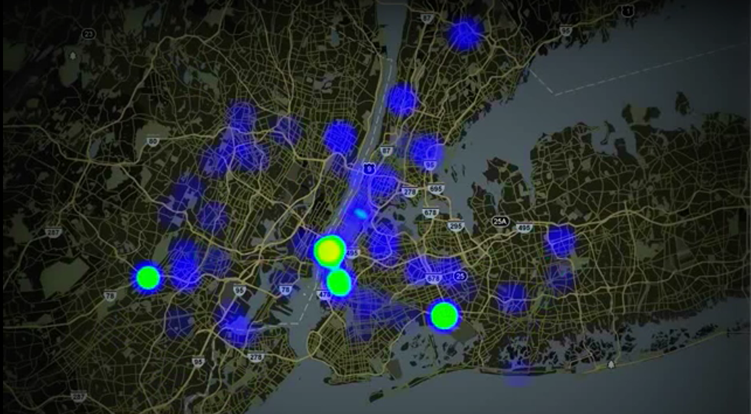

Slide 3
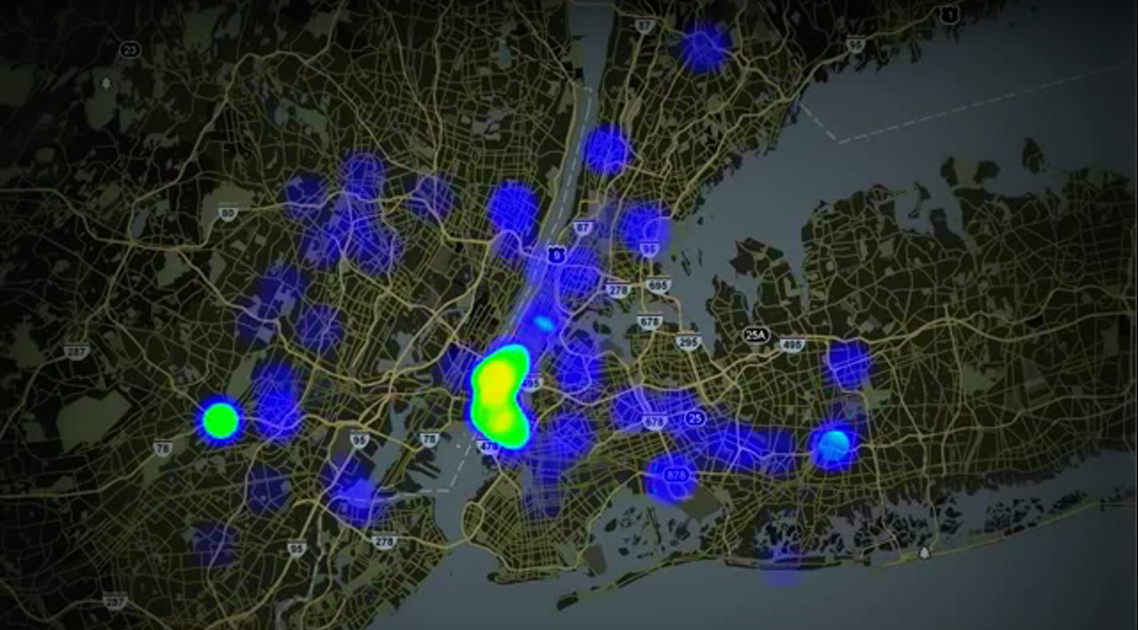

Slide 4
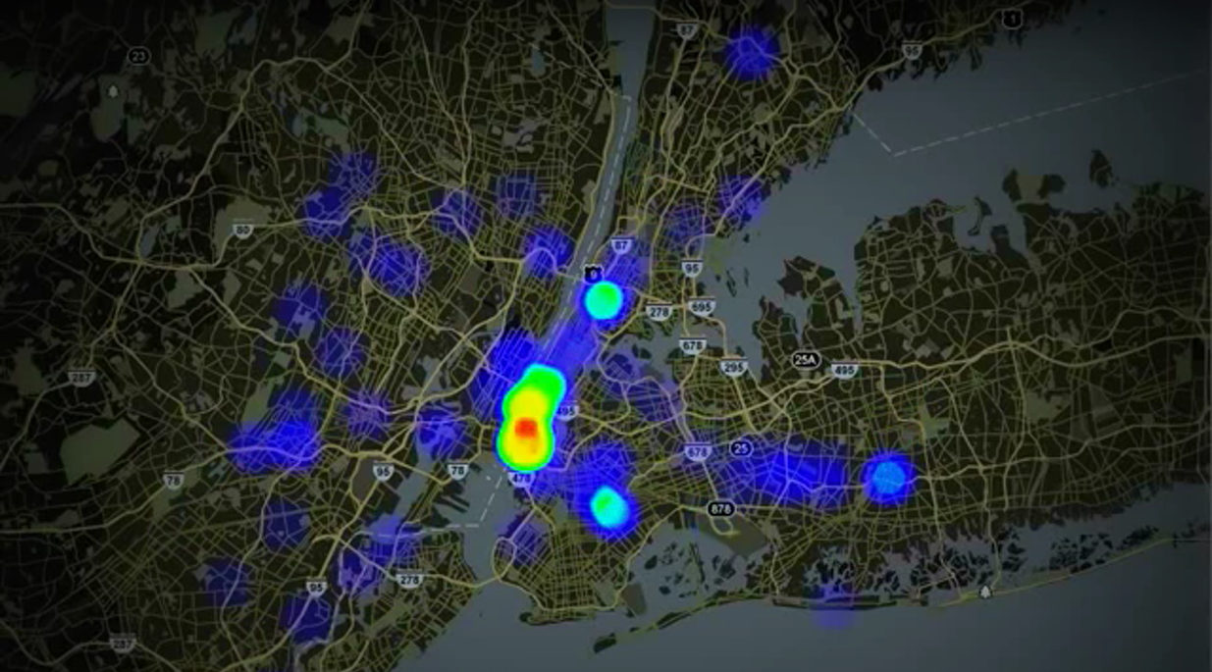

Slide 5
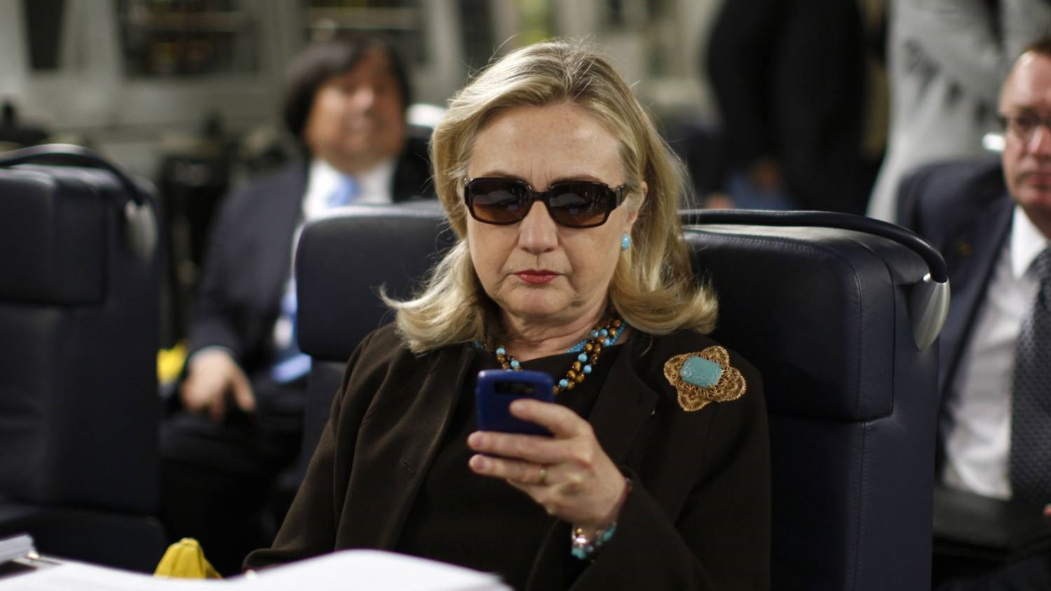
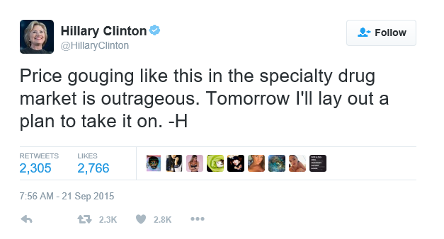
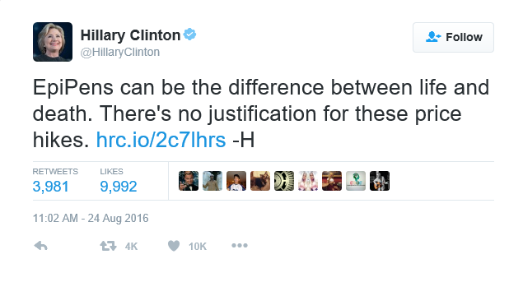
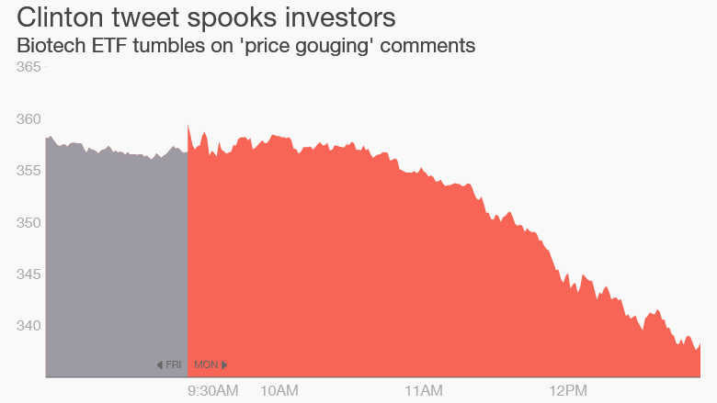

Slide 6
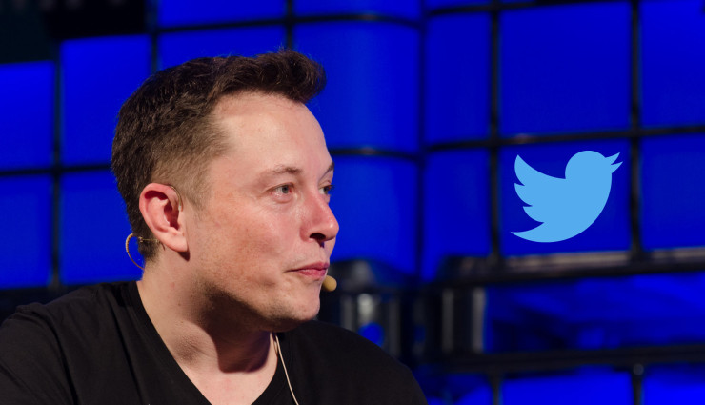
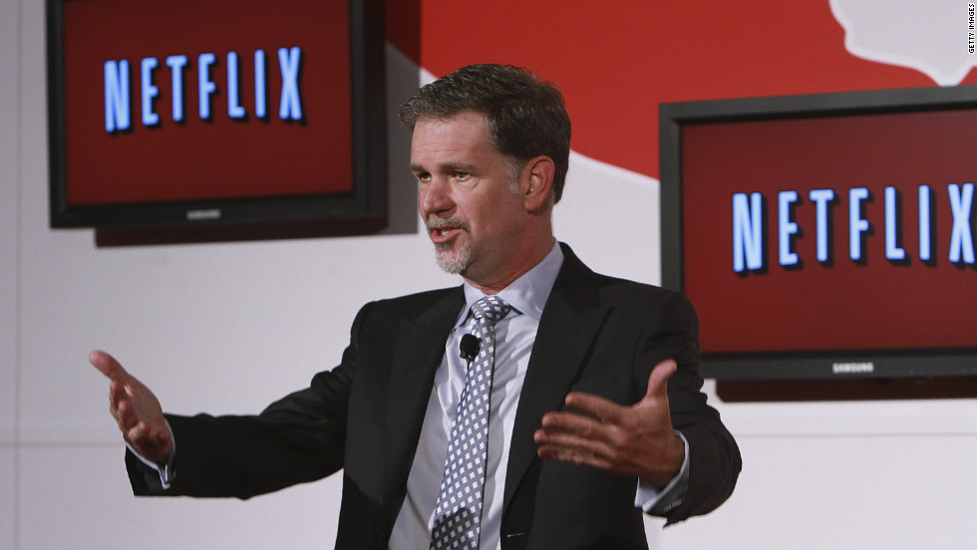
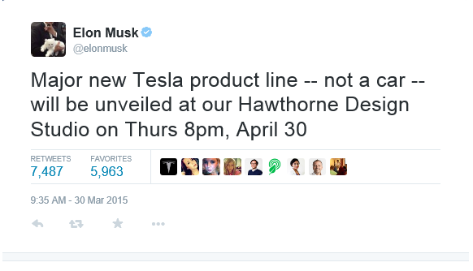
Does Social Media matter?
“Congratulations to Ted Sarandos and his amazing licensing team. Netflix monthly viewing exceeded 1 billion hours for the first time ever in June…Ted, we need even more!”

Slide 8
SEC regulation (Reg-SocMedia)
In April 2013, the SEC stated that companies can use Social Media as outlets to disclose information to investors.
“[the April 2013] decision could prompt a sea change in how companies communicate with investors and comes as regulators more broadly grapple with adapting decades-old regulations to new and evolving technologies.” (Scannell, 2013). Financial Times

Slide 9
Why Twitter?
Twitter has become the social medium of choice for Investment Relations Professionals. (Q4 Web Systems, 2012)
“Twitter is by far the most popular social media service for investor relations. You can use it to post short announcements about earnings releases, webcasts, acquisitions and other corporate news” . Dave Hogan, Director of Investor Relations and Corporate Communications, First Financial Bankshares
Financial Analysts and portfolio managers are turning to Twitter for financial information (Kiladze, 2013)
Discussions between investment firms and ETF issuers to create a Twitter ETF that tracks the mentions of a large number of firms on Twitter

Slide 10
Why does Reg-SocMedia matter?
Perceived value of Social Media (Financial Times)
Effectively moved Social Media to the public domain (similar to any corporate communication), Reg-FD
“investors not currently using social media will need to get on board, or they could possibly miss out on the latest company disclosures.” (CFA Institute)
(Financial) markets expect firms to use Social Media
On April 4, 2013, Bloomberg started integrating real-time Twitter feeds.
Executives are accountable to content (litigation, etc)
“Social Media communications can be used against a company in a lawsuit” (McHale, 2012)

Slide 11
Research Question(s)
1. Is corporate tweeting informative or just hype? Before and after Reg-SocMedia
What is informative?
What is hype?
2. Interaction between social media and more “traditional methods” of communicating information
3. Do firms strategically time their news on Twitter?

Slide 13
Links to research in Finance
Information gathering/disclosure literature
Grossman & Stiglitz (1980)
Merton (1987)
Diamond and Verrechia (1991)
Verrechia (1983)
Media in financial markets
Tetlock (2007)
Tetlock, Saar-Tsechansky and Macskassy (2008)
Engelberg and Parsons (2011)
Textual analysis
Tetlock (2007)
Loughran and McDonald (2011)

Slide 14
Literature Review (II)
Technology & Social Media
Antweiler and Frank (2004): internet stock message boards
Da, Engelberg and Gao (2011): Google SVI
Chen, De, Hu and Hwang (2014): wisdom of the crowd
Twitter
Blankespoor, Miller and White (2014): 85 technology firms
Chen, Hwang and Liu (2016): Tweeting by CEOs
Jung, Naughton, Tahoun and Wang (2015): S&P1500 earnings

Slide 15


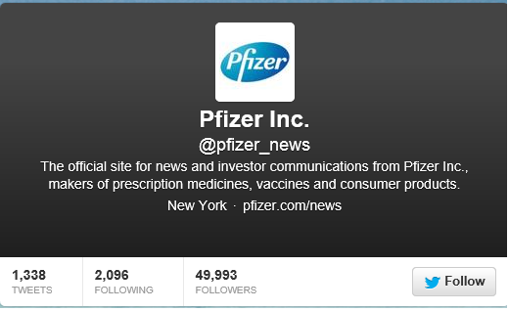
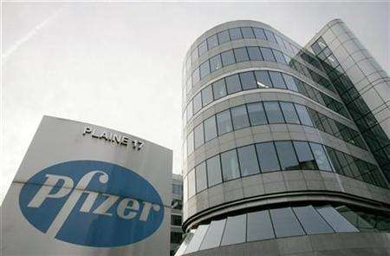
About Twitter
An electronic social Medium allowing users to communicate short messages.
140 character limit

Slide 16
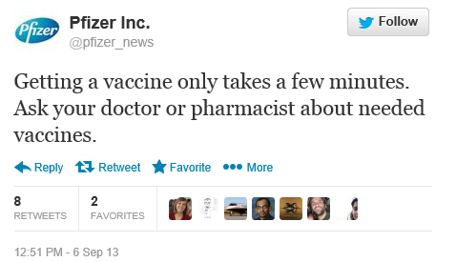
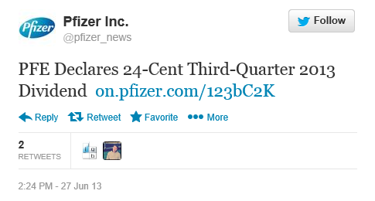
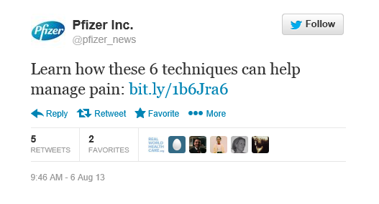
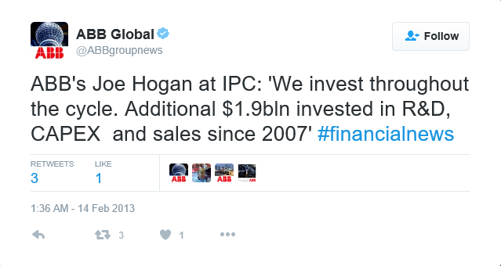
Classification of Tweets
1. General interest: represents the majority of tweets
2. Financial tweets: targeting investors or potential investors, usually a (much) smaller number of tweets

Slide 17
Classification of Tweets
1. General interest: represents the majority of tweets
2. Financial tweets: targeting investors or potential investors, usually a (much) smaller number of tweets

Slide 18
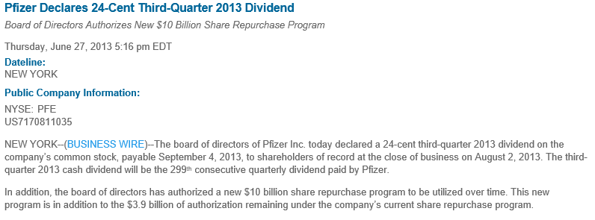
Links to more detailed information
http://pfizer.newshq.businesswire.com/press-release/pfizer-declares-24-cent-third-quarter-2013-dividend

Slide 19
Classifying financial tweets
It is possible to extract tweet that contain financial keywords from Twitter discussions (using textual analysis)
Sample financial words:
Payout
Growth
News
Market
10-k
$
Q1
etc…
Notes:
Full list of words in the appendi..

Slide 20
Number of tweeting firms (as of Oct 2013)

Slide 21
What “predicts” tweeting
Which firms are likely to use Twitter?
Higher CAPM Beta
Lower B/M (growth firms)
Larger firms
Less leverage
Less institutional ownership
Tweeting on a given day
Tweeting autocorrelation
Industry clustering
Earnings period

Slide 22
Tweeting statistics
 | Before SEC regulation | After SEC regulation | Difference
Panel A: All Tweeting
Percentage of tweeting days per firm | 50.39% | 55.80% | 5.41%***
Number of unique tweeting firms | 1359 | 1468 | 109
Panel B: Financial Tweeting
Percentage of financial tweeting days per firm | 2.76% | 2.72% | -0.04%
% days of tweets with negative tone Number of firms tweeting financial info. | 7.60% 475 | 7.16% 529 | -0.43% 54

Slide 23
Is tweeting informative?
Tweeting appears informative, but only after the SEC regulation.
Market returns respond to tweeting
Trading volume responds to tweeting

Slide 25


Number of followers
The greater the number of followers on Twitter, the greater the market response

Slide 26

Intraday evidence (15-minute window)
It appears that market respond within 15 minutes of the tweet
This is the case only after the SEC regulation
Notes:
Snapshot of followers, not continuous

Slide 27
Tweeting negative information (I)
Negative when
Friday afternoon
Outside of market hours
Not negative when
During earnings announcements period
During market hours
When short-sale constraints exist

Slide 28
Tweeting negative information (II)
Little negative news
Most tweeting is positive
Short-sale constrains
Investor inattention
More likely to tweet negative news
Outside market hours
Friday afternoon
Not during earnings season

Slide 29
Tweeting negative information (III)
This result is consistent with how we know corporations behave:
In cases of voluntary disclosure, firms select to disclose positive news only
Firms strategically time bad news on Fridays!
Firms communicate bad news outside of market hours
It appears that the same behaviour extends to Twitter!

Slide 30
Twitter and cost of capital
Can firms use Twitter, as a method of lowering information asymmetry to help reduce their cost of equity capital?
Main empirical results:
1. Firms that use Twitter experience a lower cost of equity capital
2. Firms that face the largest information asymmetry (smaller firms, firms followed by fewer analysts, and firms with the least institutional holdings) especially benefit from tweeting financial information about their firm

Slide 31
Cost of capital and Twitter
We looked at all firms since the inception of Twitter
All companies listed on the following exchanges since the inception of Twitter:
NYSE
AMEX
NASDAQ
Year | # Firms | # use Twitter | % use Twitter
2007 | 1,338 | 7 | 0.5%
2008 | 1,283 | 46 | 3.6%
2009 | 1,102 | 305 | 27.7%
2010 | 1,261 | 525 | 41.6%
2011 | 1,255 | 634 | 50.5%
2012 | 1,228 | 714 | 58.1%
2013 | 1,159 | 728 | 62.8%
Total | 8,626 | 2,963 | 34.3%

Slide 32
Twitter Use By Industry
Highest use of Twitter
Business Services
Computers
Lowest use of Twitter
Steel works
Construction
Retail
Restaurants/hotels
Mining

Slide 33
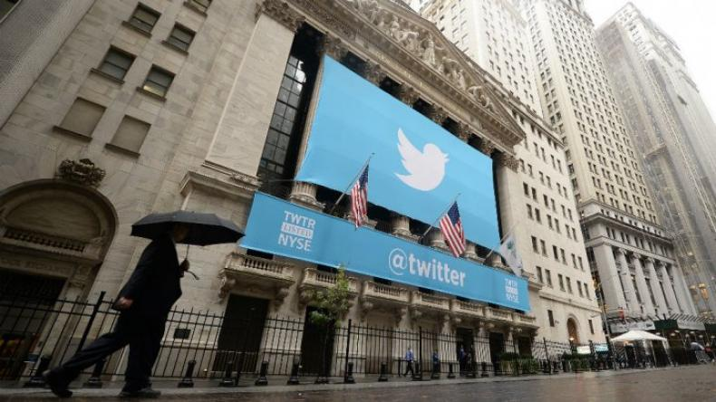
Conclusions (I)
Economic
After the SEC regulation → informative
Behavioural
Tweeting negative information → Investor inattention
Friday afternoon effect!
Methodology
Dealing with the “noise” problem in Social Media
Contributing to the textual analysis literature
Before the SEC regulation → Hype
More followers → greater impact
Regulation
SEC’s Reg-SocMedia made social media more pertinent

Slide 34
Conclusions (II)
Communicating information on Twitter can help companies lower their cost of equity capital.
Communicating financial information, in particular, can help firms facing the greatest information asymmetry lower their cost of capital.
The democratizing nature of Social Media can benefit companies!

